Slide 1
Blockchain Voting System
Powered by Microsoft Azure
Brought to you by Team Chain Reaction

Slide 2
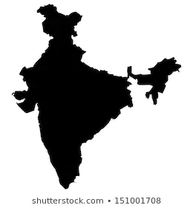
POPULATION OF 1.5 BILLION PEOPLE
YET VOTING PERCENTAGE OF 67% in 2019 ELECTION.
THAT’S ALMOST 500 MILLION PEOPLE NOT VOTING. MORE THAN THE POPULATION OF
USA

Slide 3
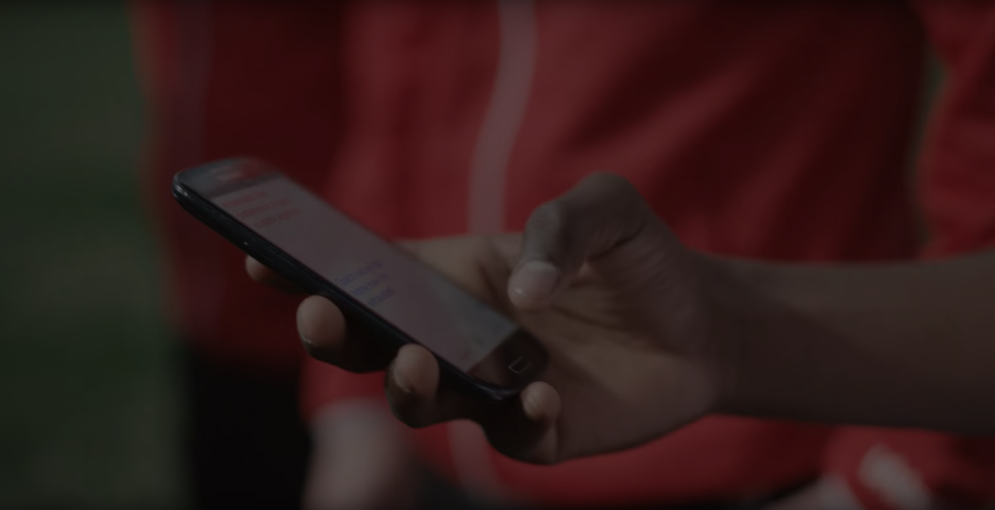
What are we trying to achieve?
To secure the existing electoral system using Azure Blockchain to allow people to cast their vote from any part of the country to ensure that every person takes part in the electoral process.

Slide 4
Why Blockchain?
Distributed Ledger
Hence there is no single point of failure
Transparency & Integrity
Data cannot be tampered with
Immutable Ledger
Third Party cannot make changes

Slide 5
Azure Services Used
Blockchain Workbench
Face API
Sendgrid
Azure Maps
Azure Cosmos DB
Computer Vision API
Azure QnA
Bing Search API
Manage the Voting Process
Detect face upload & emotion
To send OTP and voting link
Get closest booth
 |  |  |  | Azure Services
Hold data beyond blockchain
For OCR Recognition
Chatbot Service
For criminal records

Slide 6
Common Issues Plaguing the Existing Electoral Process

Slide 7
Voters not being able to travel long distances to their constituencies to vote.
Challenge
Proposed Alternative
Provide facility to vote from the nearest booth for a candidate of a particular constituency.

Slide 8
Voters misusing the Right To Vote by casting vote via multiple voter IDs.
Challenge
Proposed Alternative
Use unique Identifiers such as Aadhar to prevent misuse

Slide 9
Voters lacking general awareness about the candidates contesting elections from their respective constituencies making them prone to become victims of vote selling
Challenge
Proposed Alternative
Provide extensive details about the candidates with a scorecard of past performance and criminal records

Slide 10
Old and Sick Voters not able to cast vote by going to the booth.
Also overseas voters do not get the opportunity to be a part of the electoral process
Challenge
Proposed Alternative
Provision of a vote from home facility for such exceptional cases via OTP verification.
For Overseas voters an additional verification based on visa validity

Slide 11
Common cases of accusation of EVM tampering thereby questioning the authenticity of the entire process
Challenge
Proposed Alternative
Use Azure Blockchain to guarantee the integrity of the entire electoral system along with the provision to view timestamps of votes to ensure transparency

